Slide 1
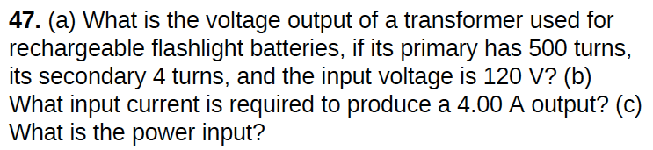



(a)
$$0.96 V$$
(b)
$$32 mA$$
(c)
All current and voltage values are rms values
$$3.84 W$$

Slide 2
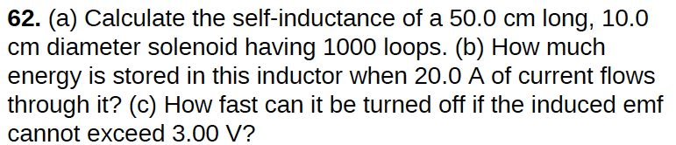






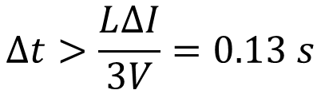
L
$$=1.97×{10}^{−2}H$$
$$=3.94 J$$
$$∆t>\frac{L∆I}{3V}=0.13 s$$
$$<3 V$$

Slide 3
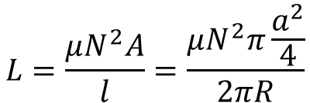
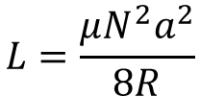
The inductor shown above is formed by winding wire N times around a toroidal piece of iron of permeability μ. The major radius of the toroid is R and the minor radius is a, with a << R. What is the inductance of this inductor?
a << R : equivalent to a solenoid
$$L=\frac{μN^{2}A}{l}=\frac{μN^{2}π\frac{a^{2}}{4}}{2πR}$$
$$L=\frac{μN^{2}a^{2}}{8R}$$

Slide 4
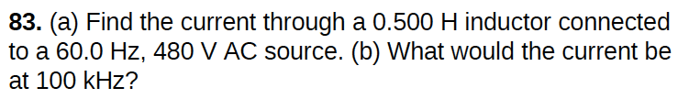
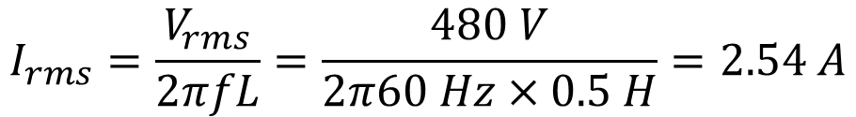
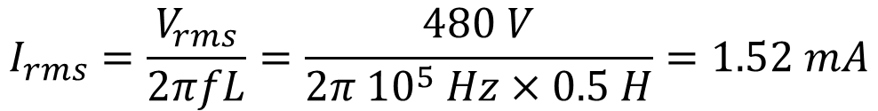
$$I_{rms}=\frac{V_{rms}}{2πfL}=\frac{480 V}{2π60 Hz×0.5 H}=2.54 A$$
$$I_{rms}=\frac{V_{rms}}{2πfL}=\frac{480 V}{2π {10}^{5} Hz×0.5 H}=1.52 mA$$

Slide 5
If the current changes in an air core inductor having a self- inductance of 25 x 10⁻⁵ H from zero to 1.0 A in 0.10 sec, what is the magnitude and direction of the self-induced emf?
E = - L ΔI/Δt = (-25 × 10⁻⁵ ) 1/ 0.10 = -2.5 × 10⁻³ V
What is the energy required to establish a magnetic field by a 5.00 H inductor carrying a current of 10.0 A?
E = ½ I² L = 250 J

Slide 6

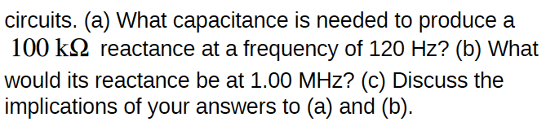
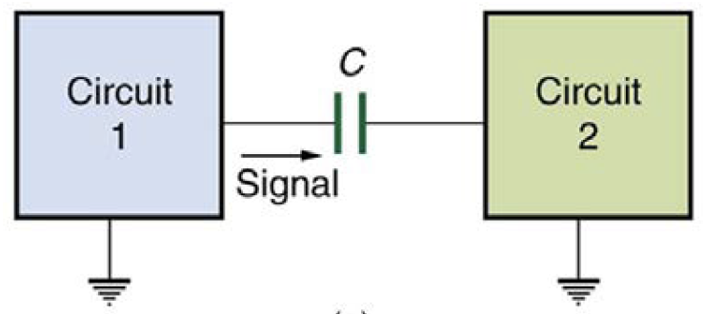

(a) C= 13.3 nF
(b) XC= 12 Ω
Notes:
filter 过滤

Slide 7
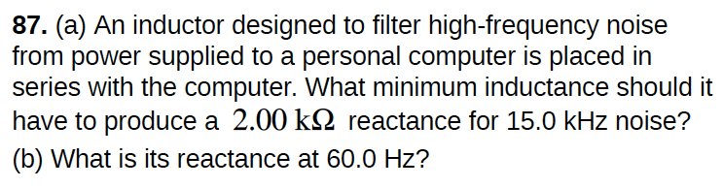

$$X_{L}=2πfL$$
(a) L=21.2 mH
(b) XL=8 Ω

Slide 8
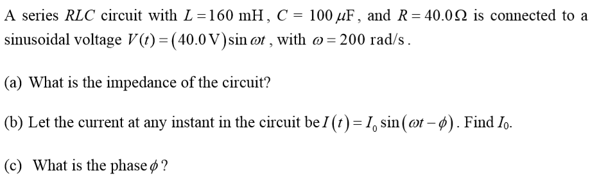



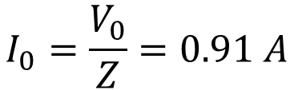

$$=43.86 Ω$$
$$I_{0}=\frac{V_{0}}{Z}=0.91 A$$
$$cosφ=\frac{R}{Z}=0.91$$
$$φ=−{24.2}^{o}$$

Slide 9
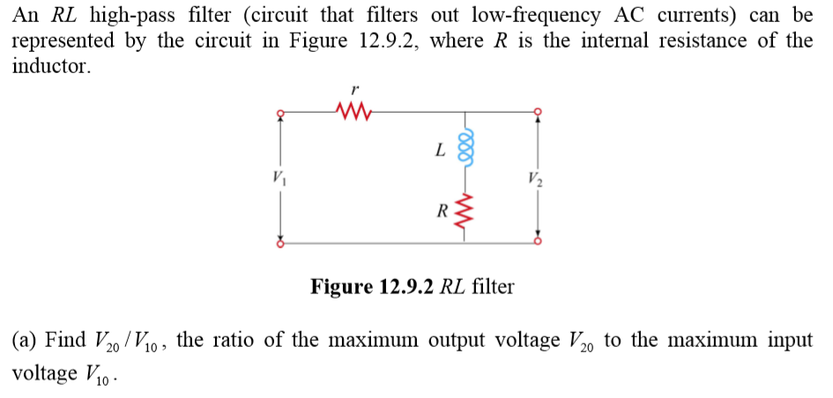

Slide 10

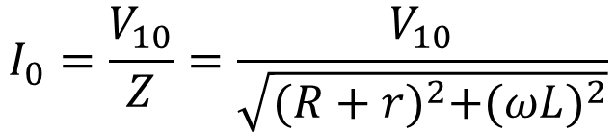



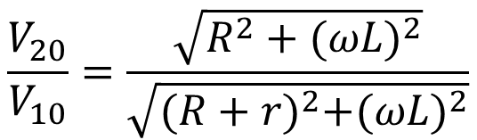
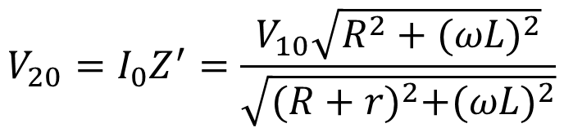
$$Z=\sqrt{{(R+r)}^{2}+{(ωL)}^{2}}$$
$$I_{0}=\frac{V_{10}}{Z}=\frac{V_{10}}{\sqrt{{(R+r)}^{2}+{(ωL)}^{2}}}$$
$$Z^{′}=\sqrt{R^{2}+{(ωL)}^{2}}$$
$$V_{20}=I_{0}Z^{′}=\frac{V_{10}\sqrt{R^{2}+{(ωL)}^{2}}}{\sqrt{{(R+r)}^{2}+{(ωL)}^{2}}}$$
$$\frac{V_{20}}{V_{10}}=\frac{\sqrt{R^{2}+{(ωL)}^{2}}}{\sqrt{{(R+r)}^{2}+{(ωL)}^{2}}}$$
$$ω=34.64 r/s$$
$$f=5.52 Hz$$

Slide 11
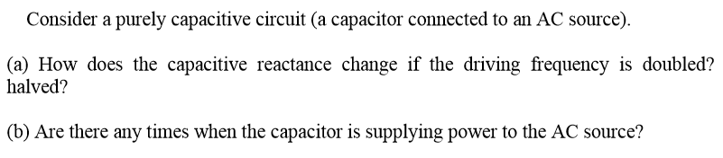
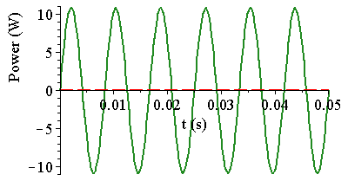
frequency | reactance
doubled | halved
halved | doubled
Energy going back to the AC source

Slide 12

$$φ=±\frac{π}{3}$$
It could be leading or lagging.

Slide 13
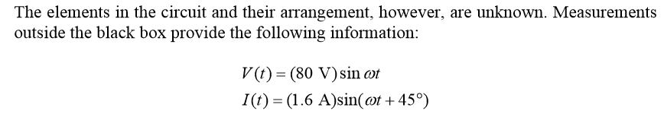
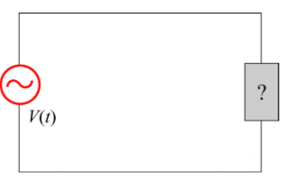
No
resonance = resistive
I
√
√
maybe
V_{C}
V
V_{R}
V_{L}

Slide 14

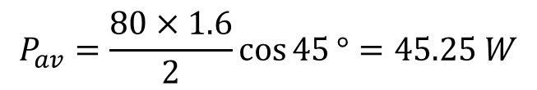
$$P_{av}=\frac{80×1.6}{2}\cos{45}°=45.25 W$$

Slide 15
In the circuit shown above, the maximum generator voltage V₀ is fixed. Which of the following graphs best represents the amplitude I of the current in the generator as a function of the frequency ω?

Slide 16
I
High frequency
I_{C}
V
Middle frequency
I
Low frequency
I_{R}
I_{L}
I

Slide 17
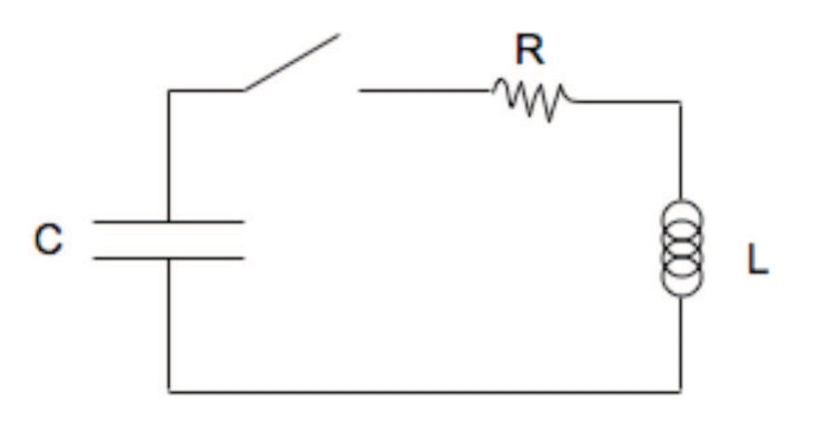


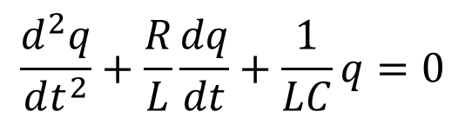
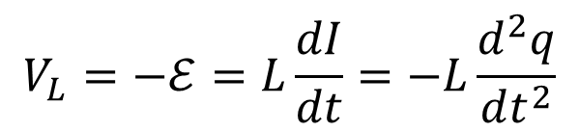
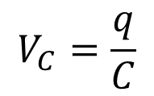
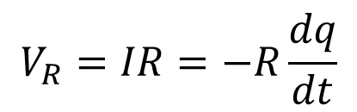
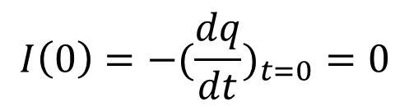
A previously-charged capacitor, of amount C and charge separation Q, is in a simple open circuit along with a resistor, R, and an inductor, L. At time t = 0, a switch is closed so that this circuit now constitutes a single, closed, series circuit. What is the time dependence of the current through the resistor?
$$V_{C}=V_{R}+V_{L}$$
$$V_{R}=IR=−R\frac{dq}{dt}$$
discharging
$$V_{C}=\frac{q}{C}$$
$$V_{L}=−ℰ=L\frac{dI}{dt}=−L\frac{d^{2}q}{dt^{2}}$$
$$\frac{d^{2}q}{dt^{2}}+\frac{R}{L}\frac{dq}{dt}+\frac{1}{LC}q=0$$
$$q\left(0\right)=Q$$
$$I\left(0\right)=−(\frac{dq}{dt})_{t=0}=0$$

Slide 18





Damping
A force that opposes motion (friction, air resistance ,…, etc.)
*Proportional to velocity
a differential equation
Solution depends on relative values of k and γ
Define:

Slide 19







“underdamped” system
“critically damped” system
“overdamped” system

Slide 20
underdamped
critically damped
overdamped

Slide 21
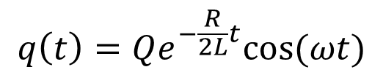
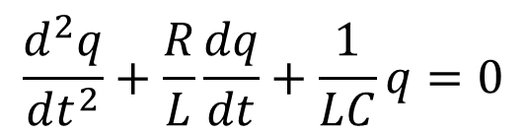
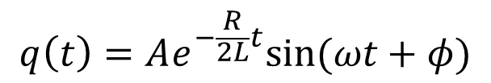
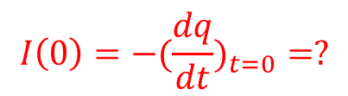
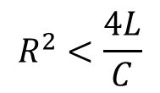
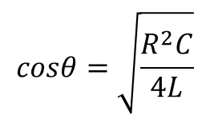
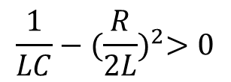
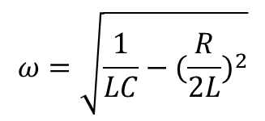

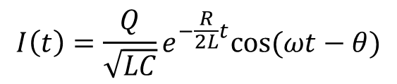
$$\frac{d^{2}q}{dt^{2}}+\frac{R}{L}\frac{dq}{dt}+\frac{1}{LC}q=0$$
underdamped
$$\frac{1}{LC}−{(\frac{R}{2L})}^{2}>0$$
$$R^{2}<\frac{4L}{C}$$
$$q\left(t\right)=Ae^{−\frac{R}{2L}t}sin⁡(ωt+φ)$$
$$q\left(t\right)=Qe^{−\frac{R}{2L}t}cos⁡(ωt)$$
$$q\left(0\right)=Q$$
$$ω=\sqrt{\frac{1}{LC}−{(\frac{R}{2L})}^{2}}$$
$$I\left(t\right)=\frac{Q}{\sqrt{LC}}e^{−\frac{R}{2L}t}cos⁡(ωt−θ)$$
$$cosθ=\sqrt{\frac{R^{2}C}{4L}}$$
$$I\left(0\right)=−(\frac{dq}{dt})_{t=0}=?$$

Slide 22
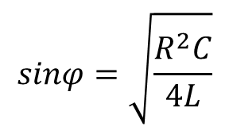
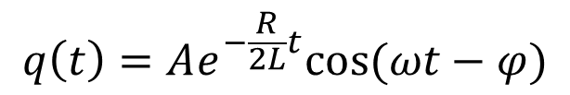
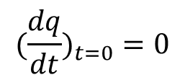
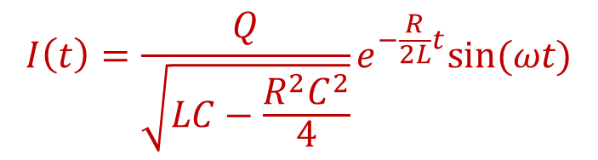

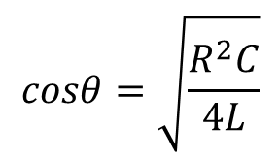
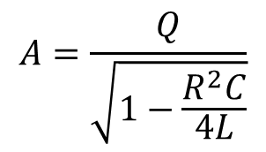
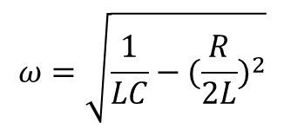

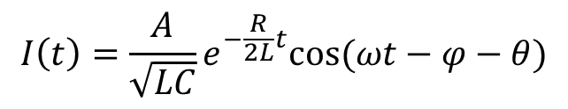

$$q\left(t\right)=Ae^{−\frac{R}{2L}t}sin⁡(ωt+φ)$$
$$q\left(t\right)=Ae^{−\frac{R}{2L}t}cos⁡(ωt−φ)$$
$$ω=\sqrt{\frac{1}{LC}−{(\frac{R}{2L})}^{2}}$$
$$cosθ=\sqrt{\frac{R^{2}C}{4L}}$$
$$I\left(t\right)=\frac{A}{\sqrt{LC}}e^{−\frac{R}{2L}t}cos⁡(ωt−φ−θ)$$
$$sinφ=\sqrt{\frac{R^{2}C}{4L}}$$
$$(\frac{dq}{dt})_{t=0}=0$$
$$A=\frac{Q}{\sqrt{1−\frac{R^{2}C}{4L}}}$$
$$q\left(0\right)=Q$$
$$Acosφ=Q$$
$$I\left(t\right)=\frac{Q}{\sqrt{LC−\frac{R^{2}C^{2}}{4}}}e^{−\frac{R}{2L}t}sin⁡(ωt)$$

